Slide 1
1 present for other children
황준화

Slide 2
Merry Christmas!
Merry Christmas!

Slide 3


If today is X-mas,

Slide 4
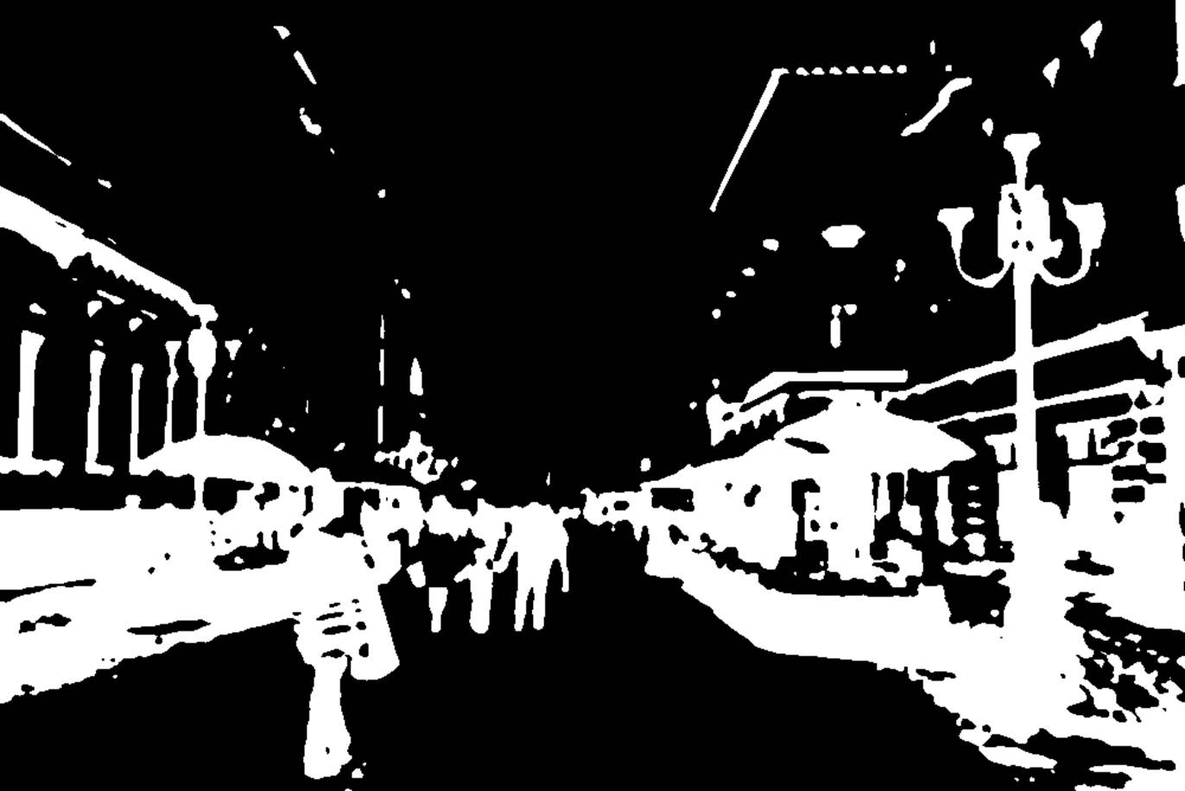
You can see this letters anywhere
You can see this letters anywhere

Slide 5















with Santa Clause and Santa’s sleigh, X-mas present.

Slide 6





Santa and ride on a reindeer sleigh.
We think global children can get a X-mas presentation from

Slide 7

But, other people can’t

Slide 8
They can’t eat fully,

Slide 9

They can’t learn in school,

Slide 10





They don’t need food, rich.

Slide 11

We need more effective solution:

Slide 12
Rights that human can live like human, human rights

Slide 13

Problems

Slide 14

Many Children are violated by human rights

Slide 15







